Slide 1
A Brief Introduction to React and Typescript
A presentation by Brandon Williams
A.K.A. The Great Brandini

Slide 2
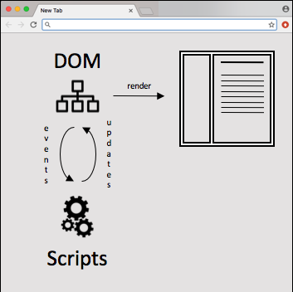
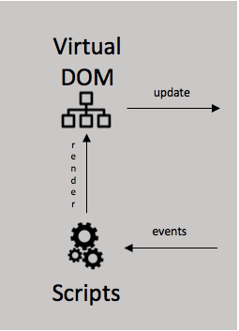
What Kinds of Things are Typescript and React?
Typicial Browser Behavior
With React
With React and Typescript
React
HTML
TypeScript
JSX
webpack
Bundled JS
HTML
JavaScript
Icon Credits: Planning by Gregor Cresnar from the Noun Project
Gears by TS Graphics from the Noun Project

Slide 3
Why add React to a project?
Single Page Application look and feel
Functional-style, one-way data flow
Virtual DOM: re-render only what has changed
What about Angular?
Angular is a “framework”, React is a “library”
React is “Just the V in MVC”, but maybe a little “C”.
Smaller and (due to virtual DOM) faster
Both “mix” markup and code, but it’s components vs. directives

Slide 4
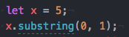
Why add TypeScript to a project?
Javascript is very dynamic – flexible but easy to break
Static (checked before “run time”) Types are much safer – fail fast
Example:
Works well with React, with a little care
What about CoffeeScript?
CoffeeScript is more about syntactic sugar and more power-per-statement
Many CoffeeScript features now exist in ES6 and TypeScript itself

Slide 5
React – Virtual Dom
React keeps its own, un-rendered copy of the DOM
When the UI needs to update, everything is re-rendered to the virtual DOM
React compares to the previous render, and updates only what changed
Diagram Credit: https://calendar.perfplanet.com/2013/diff/

Slide 6
React – JSX and markup
JSX is React’s syntax for embedding HTML into component code
A superset of html, with minor differences
In place of tags, you can use components that encapsulate presentation
Those components, in turn, are represented by their own components and tags
Although it’s all in within JS/TS, markup is confined to a “render” method.

Slide 7
TypeScript – It’s all about the types
TypeScript is a superset of plain JavaScript (pure JS is valid TS)
The primary contribution is static type safety
Every variable, function parameter, and return type can have a type
If a value doesn’t conform to its type, the compiler errors out
Also, Interfaces, Generics, Enums, and fancy compile-time logic around them
We’ll use “noImplicitAny” and “strictNullChecks” options
The first requires an explicit type when one can’t be inferred
The second prevents null/undefined from appearing where it’s not expected

Slide 8
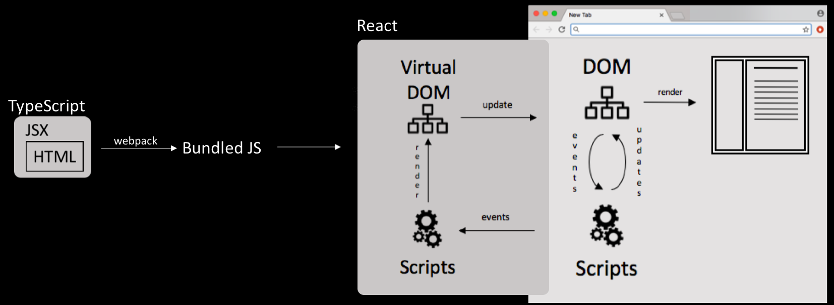
Let’s take another look

Slide 9
Snake – Putting it all together
Snake
Game
A hierarchy of components
Parent components render children as if they were plain html tags
Data passed from root node down to children
Events allow children to communicate with parents in a structured way
(Sidebar)
Arena
Snake
Food Controller
Walls
Head
[Body]
Tail
Foods
Wall
Food

Slide 11
Virtual DOM
update
DOM
render
render
events
updates
events
Scripts
JSX
HTML
Scripts

